Slide 1
Ordering a PCB
Richard McManus
April 2023

Slide 2
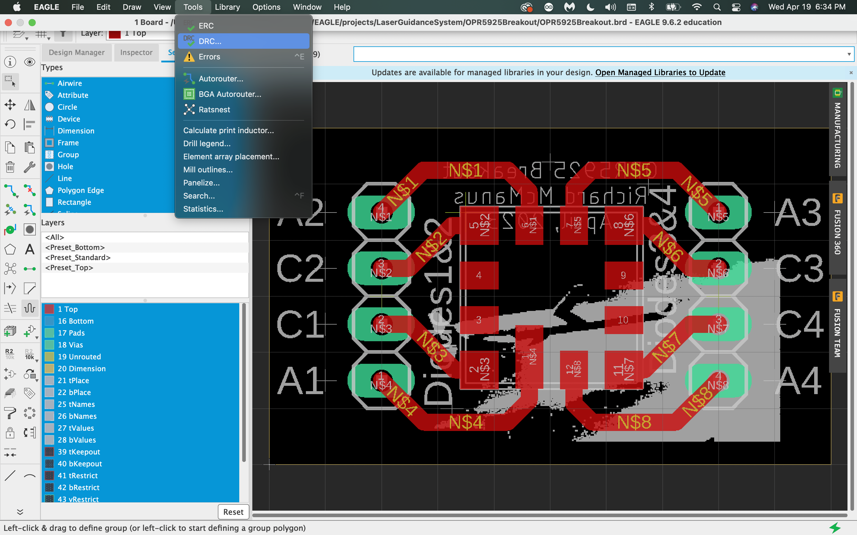
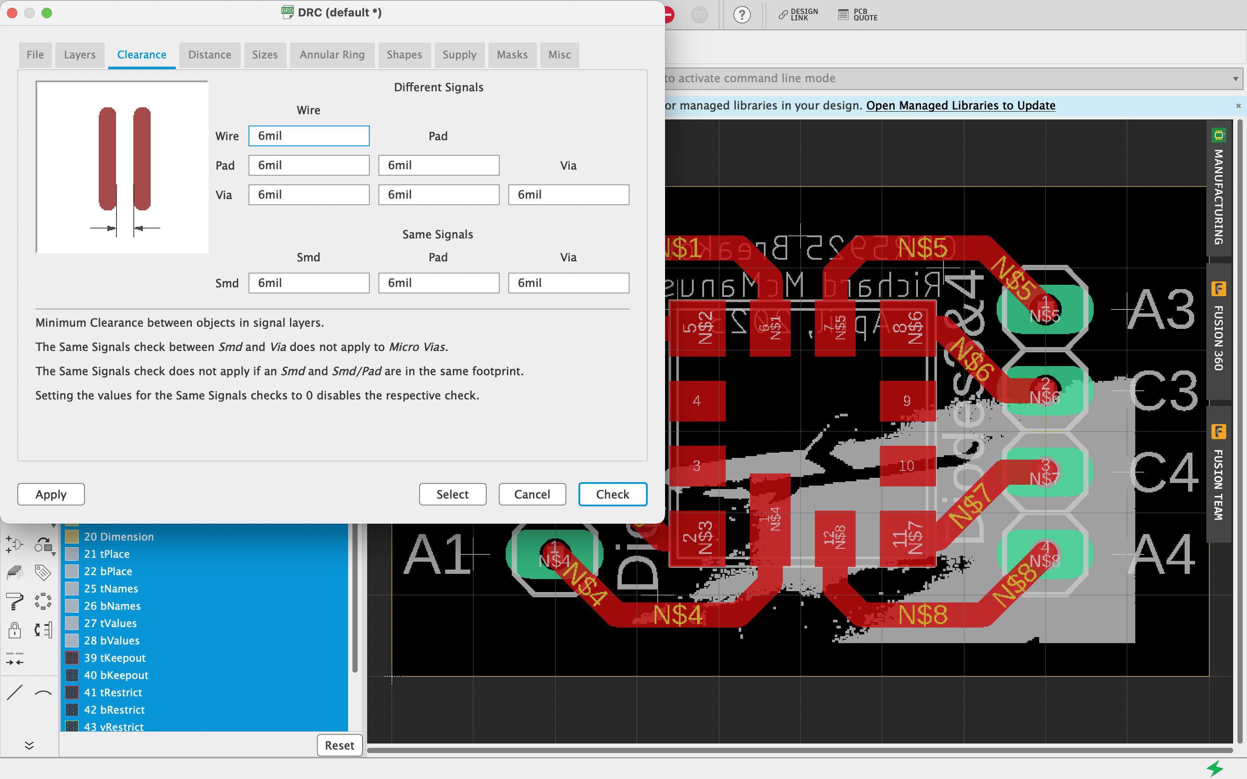
Design Rules
OSHPARK
Download and install DRU file
https://docs.oshpark.com/design-tools/eagle/design-rules-files/sample rate and frequency of waveforms
Elecrow
Manually input design rules
https://www.elecrow.com/pcb-manufacturing.html

Slide 3
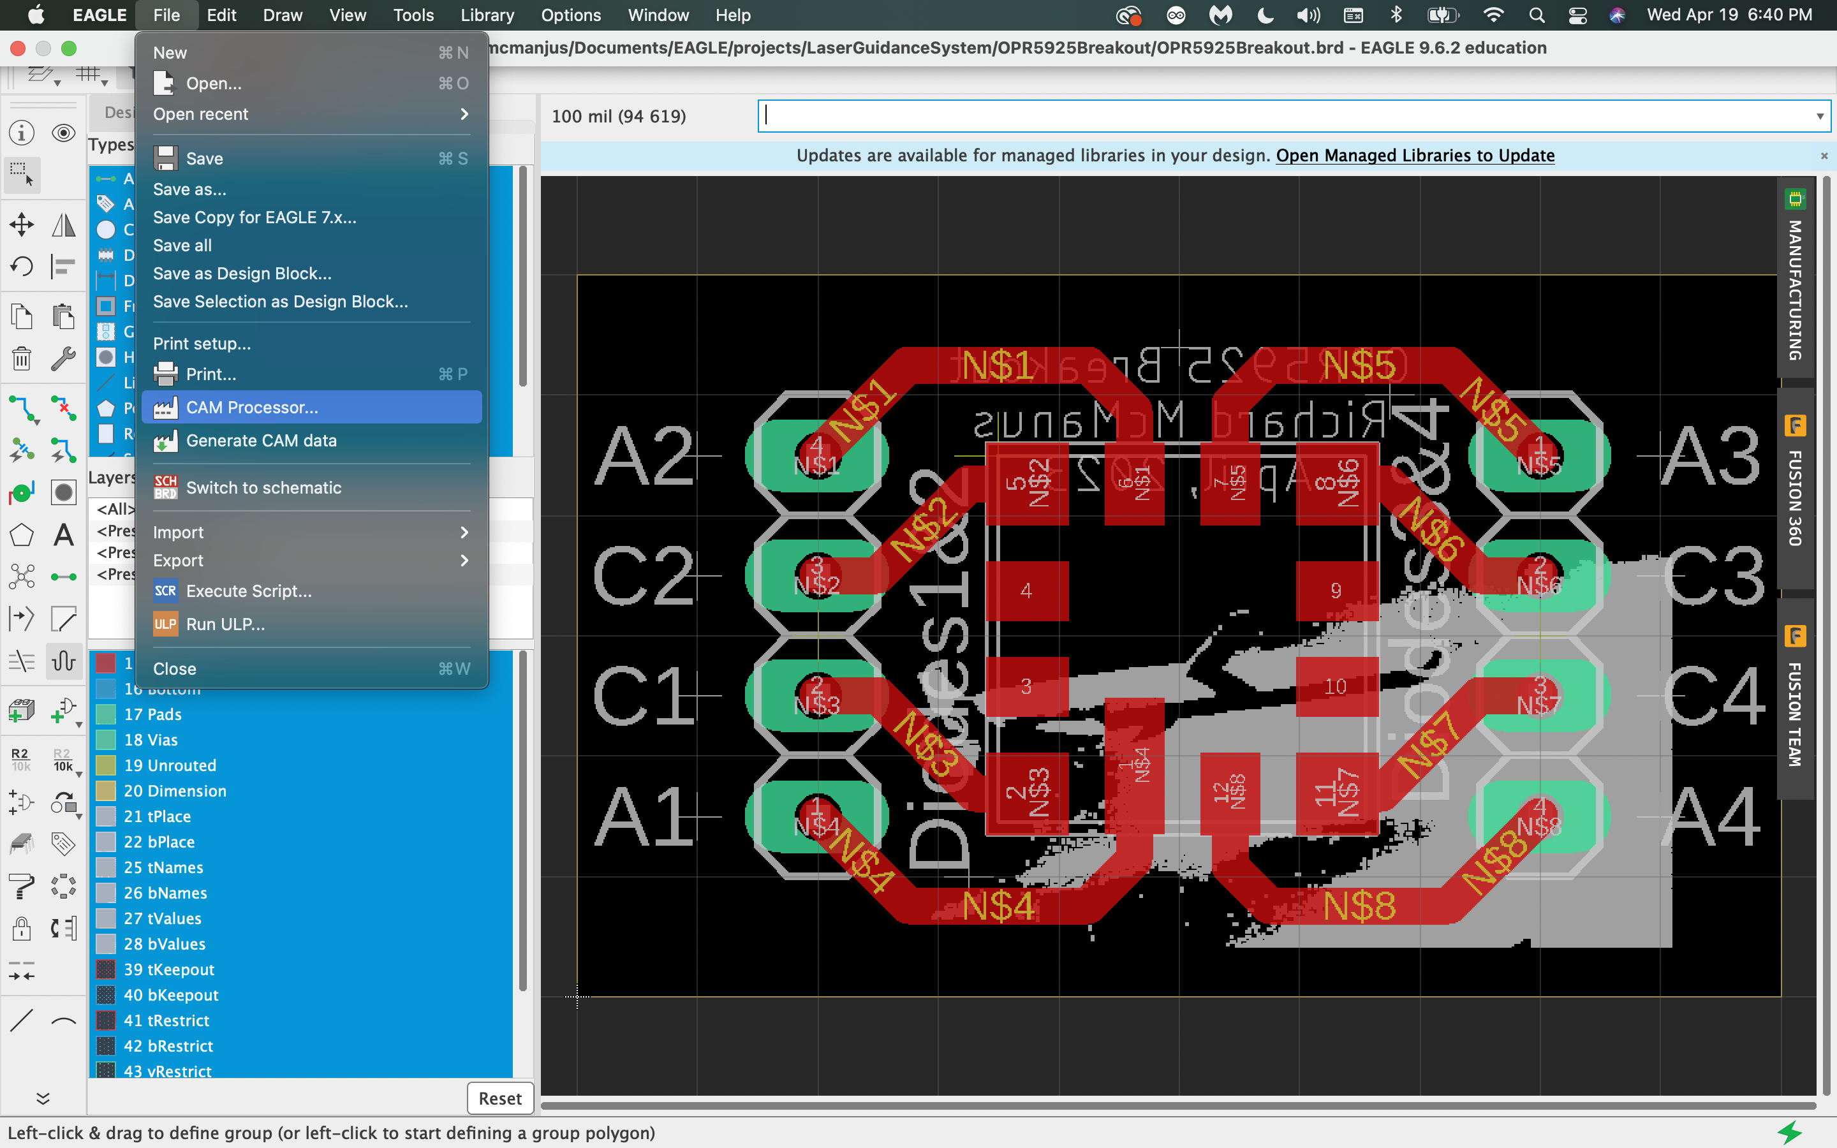
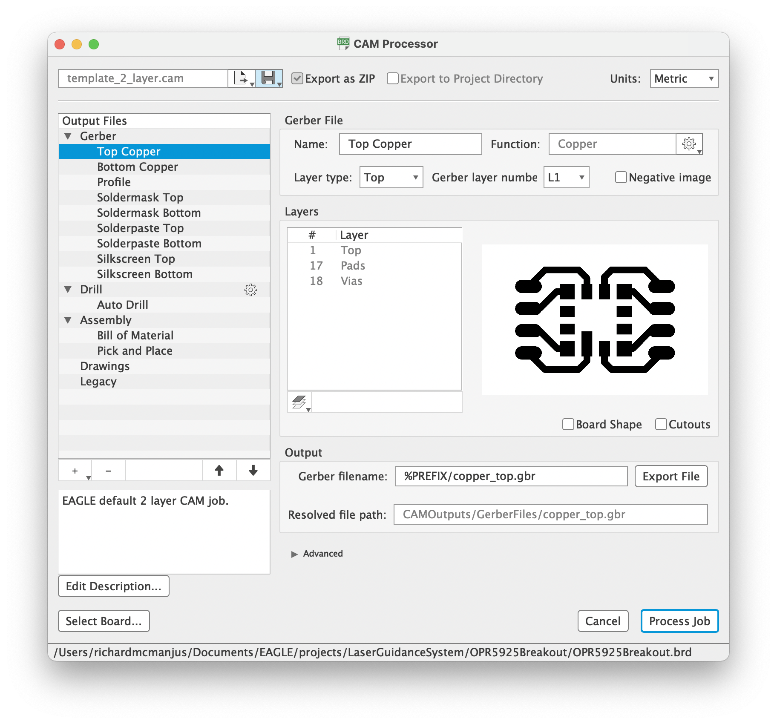
CAM Processor
Select layers to include in Gerber files
Silkscreen Top
27 tValues
200s BMP layers
Export as ZIP

Slide 4
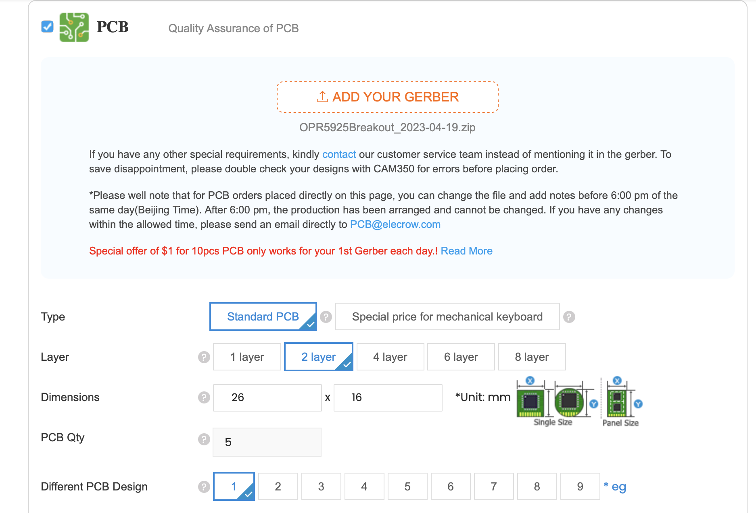
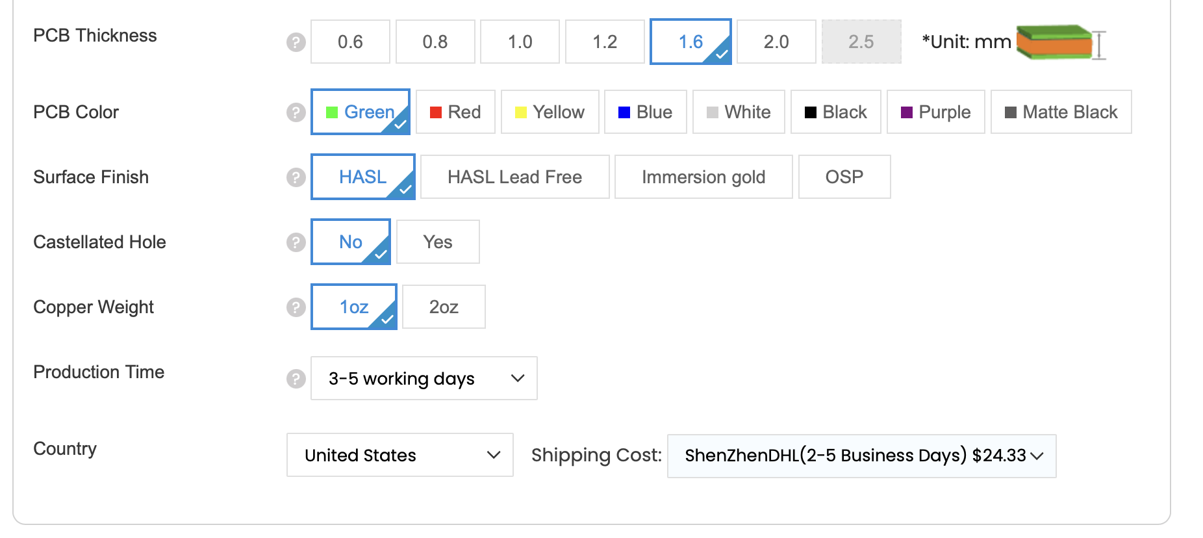
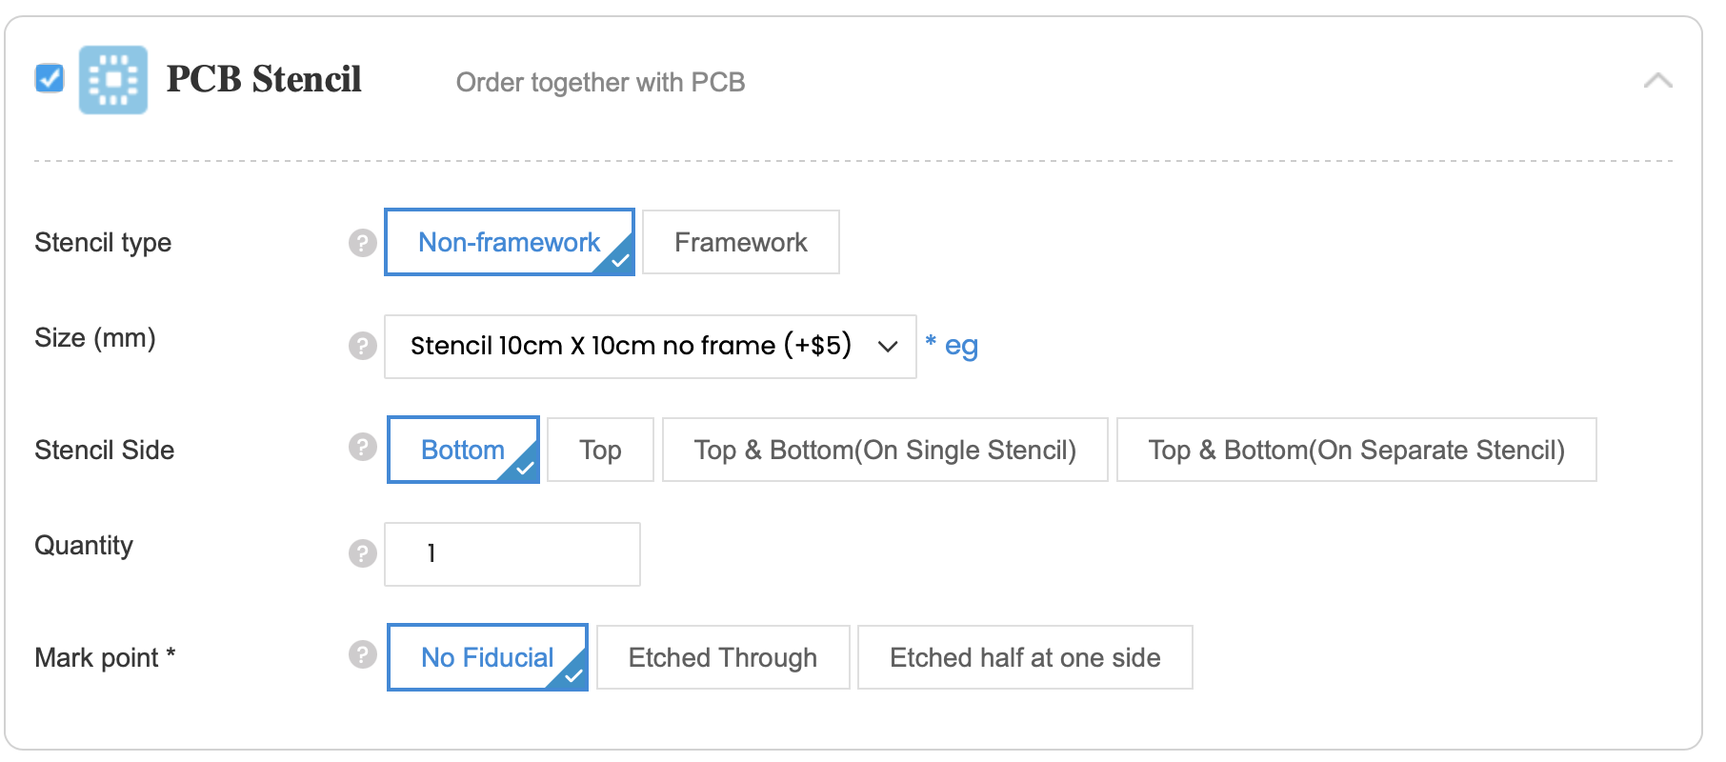
Ordering
OSHPARK
https://oshpark.com
Upload zipped Gerber files or EAGLE BRD file
Minimum quantity (3 boards)
$1.66/inch²
Third party stencil
Elecrow
https://www.elecrow.com/pcb-manufacturing.html
Upload zipped Gerber files
Minimum quantity (5 boards)
$0.20/inch²
$5 stencil (Up to 20cm x 30cm)

